Slide 1
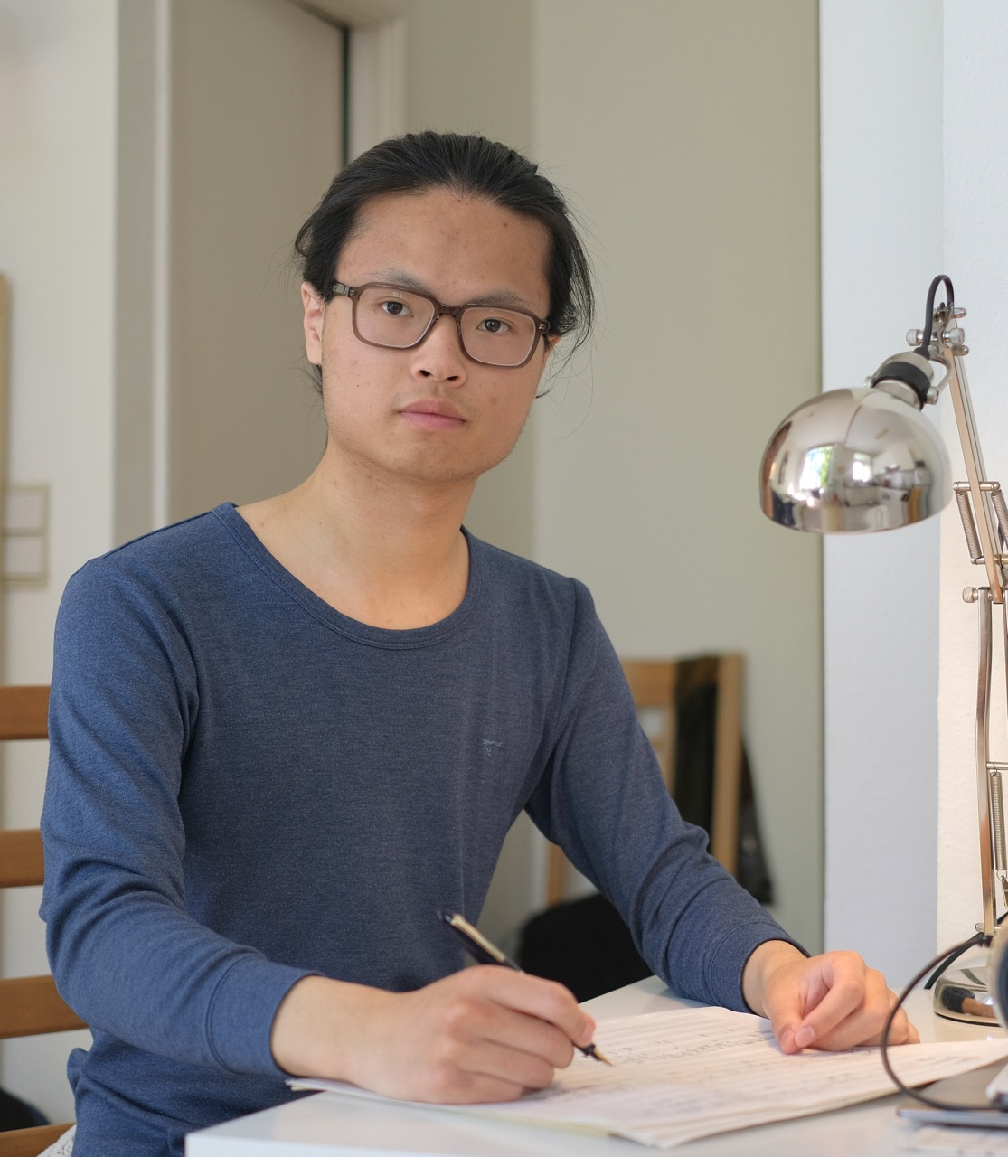





Jiawei
China, 21 years old
Academic year 26-27 / 9 months
I’m a composer study at Koninklijk Conservatorium Brussel (KCB), doing my 3rd year of bachelor. During these years I enjoyed the coorporation with my colleagues and professors. Therefore, even though the budget adjustments caused difficulties, I still hope to continue my life and studies in Belgium.
As a composer, quiteness and cleanliness are important to me. I usually stay at home and I enjoy doing housework or cooking. I can cook Chinese food and also learned some Italian recipes from my collegues. I like sweets and wine, enjoy walking in the nature, jogging in the morning, and maintaining a regular daily routine. I also like photograph, my camera is always with me. But of course, I spend most of my time on creating music. And I’d be happy to help with anything within my ability!
I’m looking forward being a part of your family, and sincerely invite you to being a part of KCB, get to know me and my music, and eventually become a special memory of my life!
“I compose music to connect with the people and world around me.”
Interests
+32 15 79 50 10
wereldgezinnen@afs.org
Notes:
Staat op de website,

Slide 2













Iconen ( te gebruiken onder “interesses”)
Allergieën:

Slide 3




























Notes:
Just drag photo and insert it on the circle.

