Slide 1
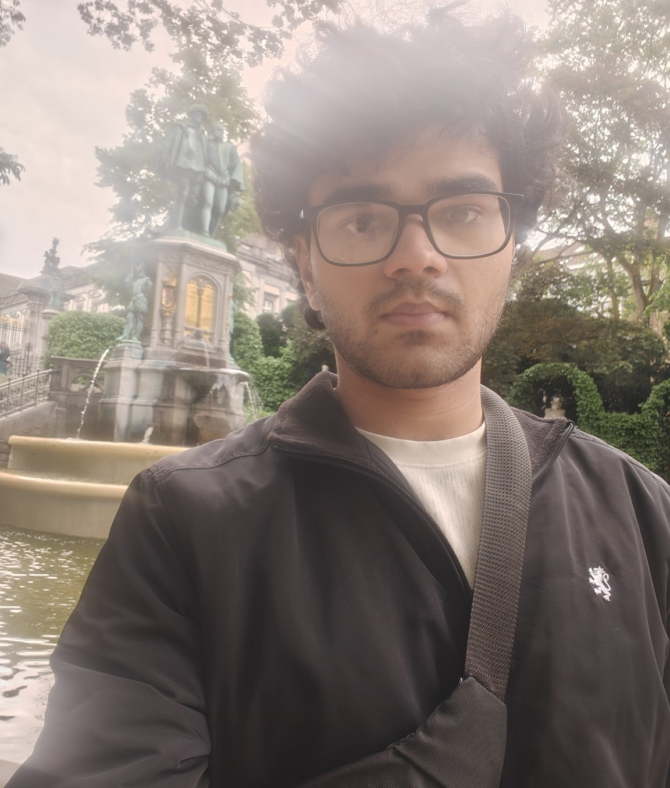




Pritish
India, 21 years
Academic year / 2026–2027
Music is at the centre of my life. I am a 21-year-old pianist and composer from India, and I have been admitted to study Music Writing at the Koninklijk Conservatorium Brussel. I love classical music and composition, and I spend much of my time playing the piano, writing music and developing my musicianship.
I am curious, creative and serious about my studies. I enjoy learning about different cultures and I am looking forward to experiencing everyday life in Belgium and becoming part of a host family. I value kindness, mutual respect and a peaceful environment in which to study and create.
Because music is my main field of study, regular piano practice is an important part of my routine. I would be very happy with a family that enjoys music and is comfortable discussing a practice schedule that works well for everyone.
“Music is at the centre of my life — I love playing the piano and creating my own music.”
Interesses
+32 15 79 50 10
wereldgezinnen@afs.org
Notes:
Staat op de website,

