Slide 1
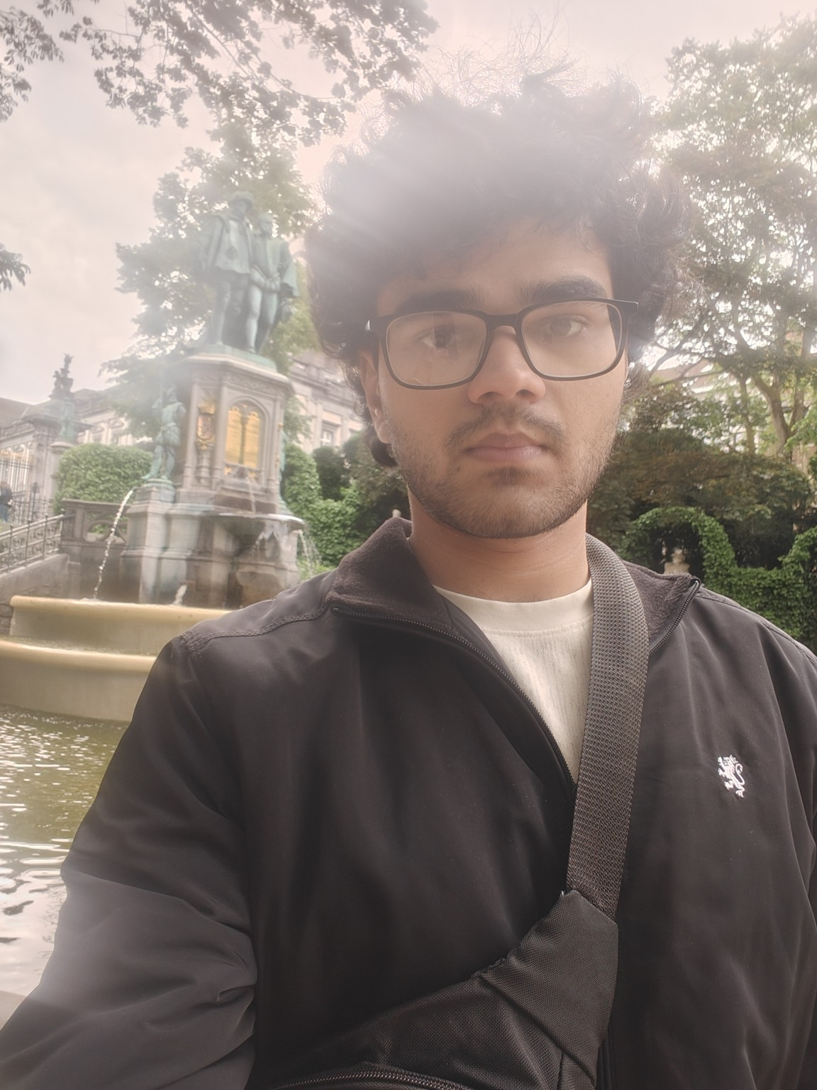
MEET YOUR POTENTIAL HOST STUDENT
Pianist • Composer
Academic year 2026–2027 • Koninklijk Conservatorium Brussel
Music is at the heart of my life. I am a 21-year-old pianist and composer from India, admitted to study Music Writing at the Koninklijk Conservatorium Brussel. I love classical, rock and film music, and spend much of my time playing the piano, composing and developing my musicianship.
WHAT MATTERS TO ME
PRITISH
I am curious, creative and genuinely excited to experience everyday life in Belgium. I value kindness, mutual respect, open communication and a peaceful home where everyone feels comfortable. I look forward to being a respectful and considerate member of your household.
Pianist • Composer
India • 21 years

Slide 2
MY INTERESTS & HOST FAMILY
A little more about me
MUSIC
CINEMA & SCIENCE
I love classical, rock and film music. Playing the piano and creating my own music are a major part of my everyday life — and something I would happily share with a host family.
I enjoy cinema and storytelling, and I am fascinated by astrophysics, the universe and big questions about the world.
LIVING TOGETHER
MY ROUTINE
What I hope to find
Regular piano practice is important because music is central to my studies. I am flexible and would be happy to discuss a practice schedule that works comfortably for everyone.
I come from a modest family background and am deeply grateful for the opportunity to study in Brussels. I would love a welcoming and respectful home where I can experience everyday Belgian life, get to know my host family, and contribute in small ways to household life.

